Slide 1
Computer Networking
Reliability And Security of Web Application
Team Number : 13
Atul Pandey ( 2018UGCS045 )
Nikhil Ranjan ( 2018UGCS005)
Divyanshu Pandey ( 2018UGCS094)
Sumit Singh Chauhan ( 2018UGCS048)
Praveen Chandel (2018UGCS074)

Slide 2
Topics
Reliability of Web Application
Web testing and quality Assurance
Web Modeling and testing technique
Modeling and Evaluation Process
Performance , Scalability and reliability issues
Web Security
Application Vulnerability
Dark Web
Attack Methodology

Slide 3
Reliability of Web Application
Abstract :
In web application Reliability is the main concern. It basically have the factors which makes web application strong, usable, mature and effective.
It deals with the rate of failure in web application.
Reliability deals with many issues. In this research performance and scalability issue, availability issue, failure cause, application fault and application error are discussed briefly.

Slide 4
WEB TESTING AND QUALITY ASSURANCE
Quality assurance and testing for web applications focus on the prevention and detection of web failures. Web failure is defined as the inability to correctly deliver information or documents required by web users. The following web failure sources are associated with different web layers
Host or network failures: Hardware or system failures at the destination host or home host, as well as network failures, may lead to web failures. These failures are mostly related to middleware or web server layers.

Slide 5
CONTD…
Browser failures: These failures are linked to problems in the web browser at the client side. These failures can be treated the same way as software product failures. Existing techniques for software testing and reliability can be used to assess, predict and improve browser reliability.
Source or content failures: Web failures can also be caused by the information source itself at the server side. In most cases these kinds of failures reveal non-compliances with user requirements. In our methodology we focus in source failures, instead of browser compatibility or host, network or other browser failures

Slide 6
Web Modeling and Testing Techniques
Different types of web modeling and testing techniques are being used in the development of web applications. This techniques include, petri nets ,model checking and statistical web modeling and testing.
Software reliability models the behavior of software systems based on its failures. Predictions such as time to next failure, meantime to failure, or total number of faults detected, are examples of measurements derived from the reliability models.
Mathematical and statistical functions provide the predictions and degrees of confidence for the predictions.

Slide 7
Modeling and Evaluation Process
Analysis of the initial conditions.
Quality attributes selection and its corresponding metrics
Measurement Process.
Choose the probability law associated with the population
Model Validation
Overall evaluation.

Slide 8
Performance, scalability and reliability issues
Each independent testing procedure has to be incorporated into a single collective scenario that would simulate the real-time use of the product implementation.
criteria to be declared a success:
no exceptions in log ﬁles;
no error messages in application and servlet engine log ﬁles;
no deadlocks or memory leaks;
no performance bottlenecks that can be attributed to size of data ;
system performs with stability beyond two hours from startup time

Slide 9
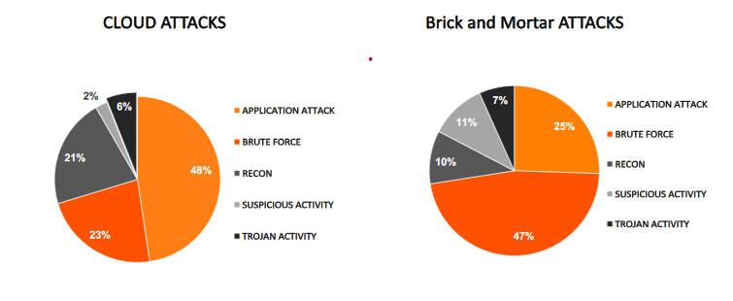
Web Application Security

Slide 10
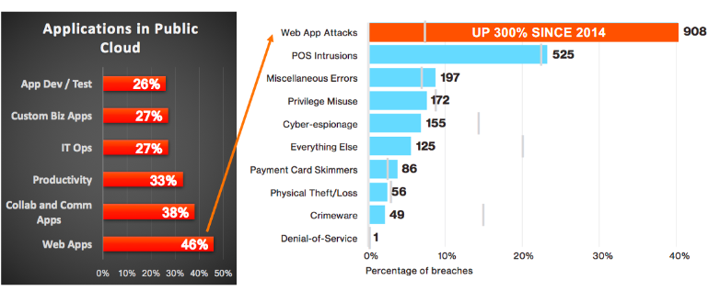
Web Apps –Prime Target for Attacker

Slide 11
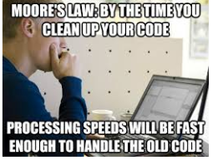
HOW WEB APPLICATION BECOME VULNERABLE
Poor coding Practice
Old Reliable Code
and Processes
Unpatched and
Unsupported Code
Lack of Security
Oversight

Slide 12
Dark Web
Encrypted network
Restricted access between Tor servers and clients
Collection of DBs and communication channels
Hidden from conventional search engines
Shares some features with Open Forums
More advanced resources and tools

Slide 13
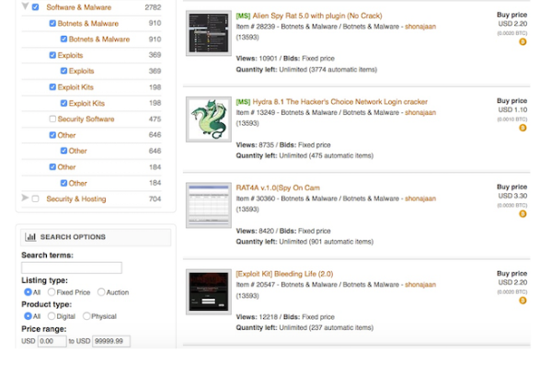
Contd…

Slide 14
Attack Methodology
Attack of opportunity-Hacker finds vulnerability within skillset- Target system and organization irrelevant
Targeted Attacks -Specific to people or organization-System resources
Low cost of entry-Open list of vulnerabilities-Targets easy to find ,Hacker’s skill-set varies

Slide 15
Why Web Security Is So Important
Hacked Websites Target Your Customers
The number of hacked sites rises rapidly
Business Reputation Loss and Drop in Revenue
Website gets blacklisted
website clean-up is more expensive than protection

Slide 16
Thank You ….!!!

